Slide 1
Graphs Breadth First Search & Depth First Search

Slide 2
Contents
Overview of Graph terminology.
Graph representation.
Breadth first search.
Depth first search. – if time permits
Pseudocode walkthrough using sample graphs.
Applications of BFS and DFS.
References.
Q & A
Working example for BFS.

Slide 3
Graph terminology - overview
A graph consists of
set of vertices V = {v₁, v₂, ….. v_{n}}
set of edges that connect the vertices E ={e₁, e₂, …. e_{m}}
Two vertices in a graph are adjacent if there is an edge connecting the vertices.
Two vertices are on a path if there is a sequences of vertices beginning with the first one and ending with the second one
Graphs with ordered edges are directed. For directed graphs, vertices have in and out degrees.
Weighted Graphs have values associated with edges.

Slide 4
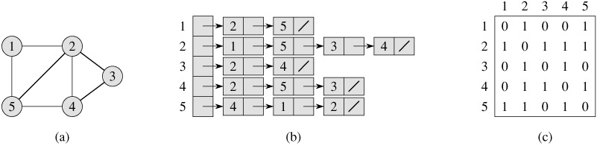
Graph representation – undirected
graph
Adjacency list
Adjacency matrix

Slide 5
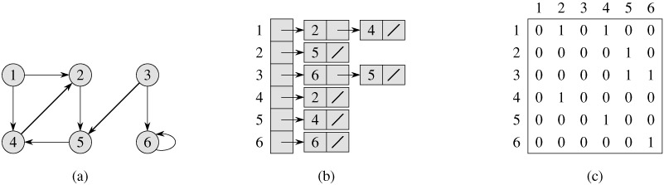
Graph representation – directed
graph
Adjacency list
Adjacency matrix

Slide 6
Some notes
Adjacency list representation is usually preferred since it is more efficient in representing sparse graphs.
Graphs for which |E| is much less than |V|²
Adjacency list requires memory of the order of θ(V+E)
Searching a graph means systematically following the edges of the graph so as to visit the vertices.

Slide 7
Breadth first search
Given
a graph G=(V,E) – set of vertices and edges
a distinguished source vertex s
Breadth first search systematically explores the edges of G to discover every vertex that is reachable from s.
It also produces a ‘breadth first tree’ with root s that contains all the vertices reachable from s.
For any vertex v reachable from s, the path in the breadth first tree corresponds to the shortest path in graph G from s to v.
It works on both directed and undirected graphs. However, we will explore only directed graphs.

Slide 8
Breadth first search
It is so named because
It discovers all vertices at distance k from s before discovering vertices at distance k+1.
Animation:
http://en.wikipedia.org/wiki/Image:Animated_BFS.gif

Slide 9
Breadth first search - concepts
To keep track of progress, it colors each vertex - white, gray or black.
All vertices start white.
A vertex discovered first time during the search becomes nonwhite.
All vertices adjacent to black ones are discovered. Whereas, gray ones may have some white adjacent vertices.
Gray represent the frontier between discovered and undiscovered vertices.

Slide 10
BFS – How it produces a Breadth first tree
The tree initially contains only root. – s
Whenever a vertex v is discovered in scanning adjacency list of vertex u
Vertex v and edge (u,v) are added to the tree.

Slide 11
BFS - algorithm
BFS(G, s) // G is the graph and s is the starting node
1 for each vertex u ∈ V [G] - {s}
2 do color[u] ← WHITE // color of vertex u
3 d[u] ← ∞ // distance from source s to vertex u
4 π[u] ← NIL // predecessor of u
5 color[s] ← GRAY
6 d[s] ← 0
7 π[s] ← NIL
8 Q ← Ø // Q is a FIFO - queue
9 ENQUEUE(Q, s)
10 while Q ≠ Ø // iterates as long as there are gray vertices. Lines 10-18
11 do u ← DEQUEUE(Q)
12 for each v ∈ Adj[u]
13 do if color[v] = WHITE // discover the undiscovered adjacent vertices
14 then color[v] ← GRAY // enqueued whenever painted gray
15 d[v] ← d[u] + 1
16 π[v] ← u
17 ENQUEUE(Q, v)
18 color[u] ← BLACK // painted black whenever dequeued

Slide 12
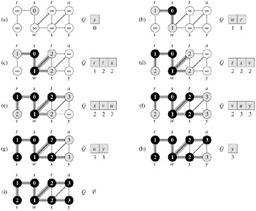
Breadth First Search - example

Slide 13
Breadth first search - analysis
Enqueue and Dequeue happen only once for each node. - O(V).
Sum of the lengths of adjacency lists – θ(E) (for a directed graph)
Initialization overhead O(V)
Total runtime O(V+E)

Slide 14
Depth first search
It searches ‘deeper’ the graph when possible.
Starts at the selected node and explores as far as possible along each branch before backtracking.
Vertices go through white, gray and black stages of color.
White – initially
Gray – when discovered first
Black – when finished i.e. the adjacency list of the vertex is completely examined.
Also records timestamps for each vertex
d[v] when the vertex is first discovered
f[v] when the vertex is finished

Slide 15
Depth first search - algorithm
DFS(G)
1 for each vertex u ∈ V [G]
2 do color[u] ← WHITE // color all vertices white, set their parents NIL
3 π[u] ← NIL
4 time ← 0 // zero out time
5 for each vertex u ∈ V [G] // call only for unexplored vertices
6 do if color[u] = WHITE // this may result in multiple sources
7 then DFS-VISIT(u)
DFS-VISIT(u)
1 color[u] ← GRAY ▹White vertex u has just been discovered.
2 time ← time +1
3 d[u] time // record the discovery time
4 for each v ∈ Adj[u] ▹Explore edge(u, v).
5 do if color[v] = WHITE
6 then π[v] ← u // set the parent value
7 DFS-VISIT(v) // recursive call
8 color[u] BLACK ▹ Blacken u; it is finished.
9 f [u] ▹ time ← time +1

Slide 16
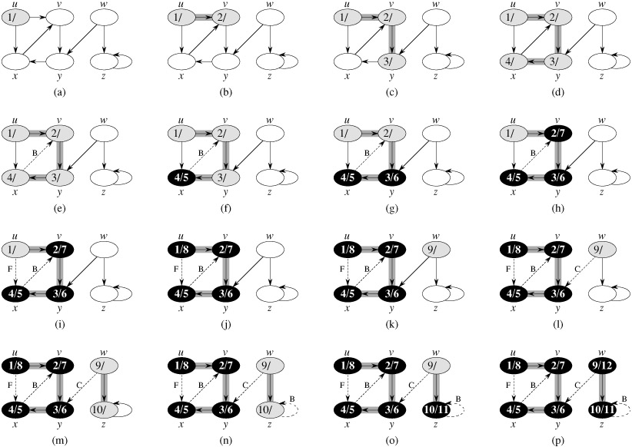
Depth first search – example

Slide 17
Depth first search - analysis
Lines 1-3, initialization take time Θ(V).
Lines 5-7 take time Θ(V), excluding the time to call the DFS-VISIT.
DFS-VISIT is called only once for each node (since it’s called only for white nodes and the first step in it is to paint the node gray).
Loop on line 4-7 is executed |Adj(v)| times. Since, ∑_{vєV} |Adj(v)| = Ө (E), the total cost of DFS-VISIT it θ(E)
The total cost of DFS is θ(V+E)

Slide 18
BFS and DFS - comparison
Space complexity of DFS is lower than that of BFS.
Time complexity of both is same – O(|V|+|E|).
The behavior differs for graphs where not all the vertices can be reached from the given vertex s.
Predecessor subgraphs produced by DFS may be different than those produced by BFS. The BFS product is just one tree whereas the DFS product may be multiple trees.

Slide 19
BFS and DFS – possible applications
Exploration algorithms in Artificial Intelligence
Possible to use in routing / exploration wherever travel is involved. E.g.,
I want to explore all the nearest pizza places and want to go to the nearest one with only two intersections.
Find distance from my factory to every delivery center.
Most of the mapping software (GOOGLE maps, YAHOO(?) maps) should be using these algorithms.
Companies like Waste Management, UPS and FedEx?
Applications of DFS
Topologically sorting a directed acyclic graph.
List the graph elements in such an order that all the nodes are listed before nodes to which they have outgoing edges.
Finding the strongly connected components of a directed graph.
List all the subgraphs of a strongly connected graph which themselves are strongly connected.

Slide 20
References
Data structures with C++ using STL by Ford, William; Topp, William; Prentice Hall.
Introduction to Algorithms by Cormen, Thomas et. al., The MIT press.
http://en.wikipedia.org/wiki/Graph_theory
http://en.wikipedia.org/wiki/Depth_first_search

Slide 21
Working example for BFS
Everett
North Bend
Seattle
Centralia
* Assume – edge value 1 for all
Cases:
Start with Everett
Start with Olympia
Olympia
Spokane
Portland

